Slide 1

Code editor that feels like a spreadsheet
Notes:
Mesh Spreadsheet started as a JavaScript project but it’s moving to k as it offers better data structures, punchier syntax, a simple built-in parsing model, and better data storage and processing capabilities. The existing prototype is written entirely in Shakti’s k7 with a client-side JavaScript-based frontend.

Slide 2
Shakti formulas
Edit in grid, store as text
Headless + streaming
Run sheets in production
Notes:
Mesh is a spreadsheet UI wrapper around a text file editor. Actions on the grid are automatically translated to changes in the code via manipulations of the abstract syntax tree. The ultimate goal is to allow people to write real programs in a spreadsheet editor, and I’ll talk through how these features as implemented in the forthcoming Shakti version make that dream possible, as well as a couple of demos of how they can be put in practice (based on the previous prototype which was written in JavaScript).
I’ve had feedback that Mesh will be a useful education tool, but my real goal is to allow creation of spreadsheets that can act as real programs. You’ve probably heard of the phrase (aphorism?) ‘spreadsheets are code’, but existing spreadsheet programs have limitations that prevent their integration with traditional codebases. Mesh aims to change that, and this preso will cover three areas of design focus.

Slide 3

Photo by NASA on Unsplash: https://unsplash.com/s/photos/world-map?utm_source=unsplash&utm_medium=referral&utm_content=creditCopyText
Notes:
See the big picture of a codebase. Key data structures. Group together related concepts on the sheet, or use it to show ‘flow’ from left to right.

Slide 4
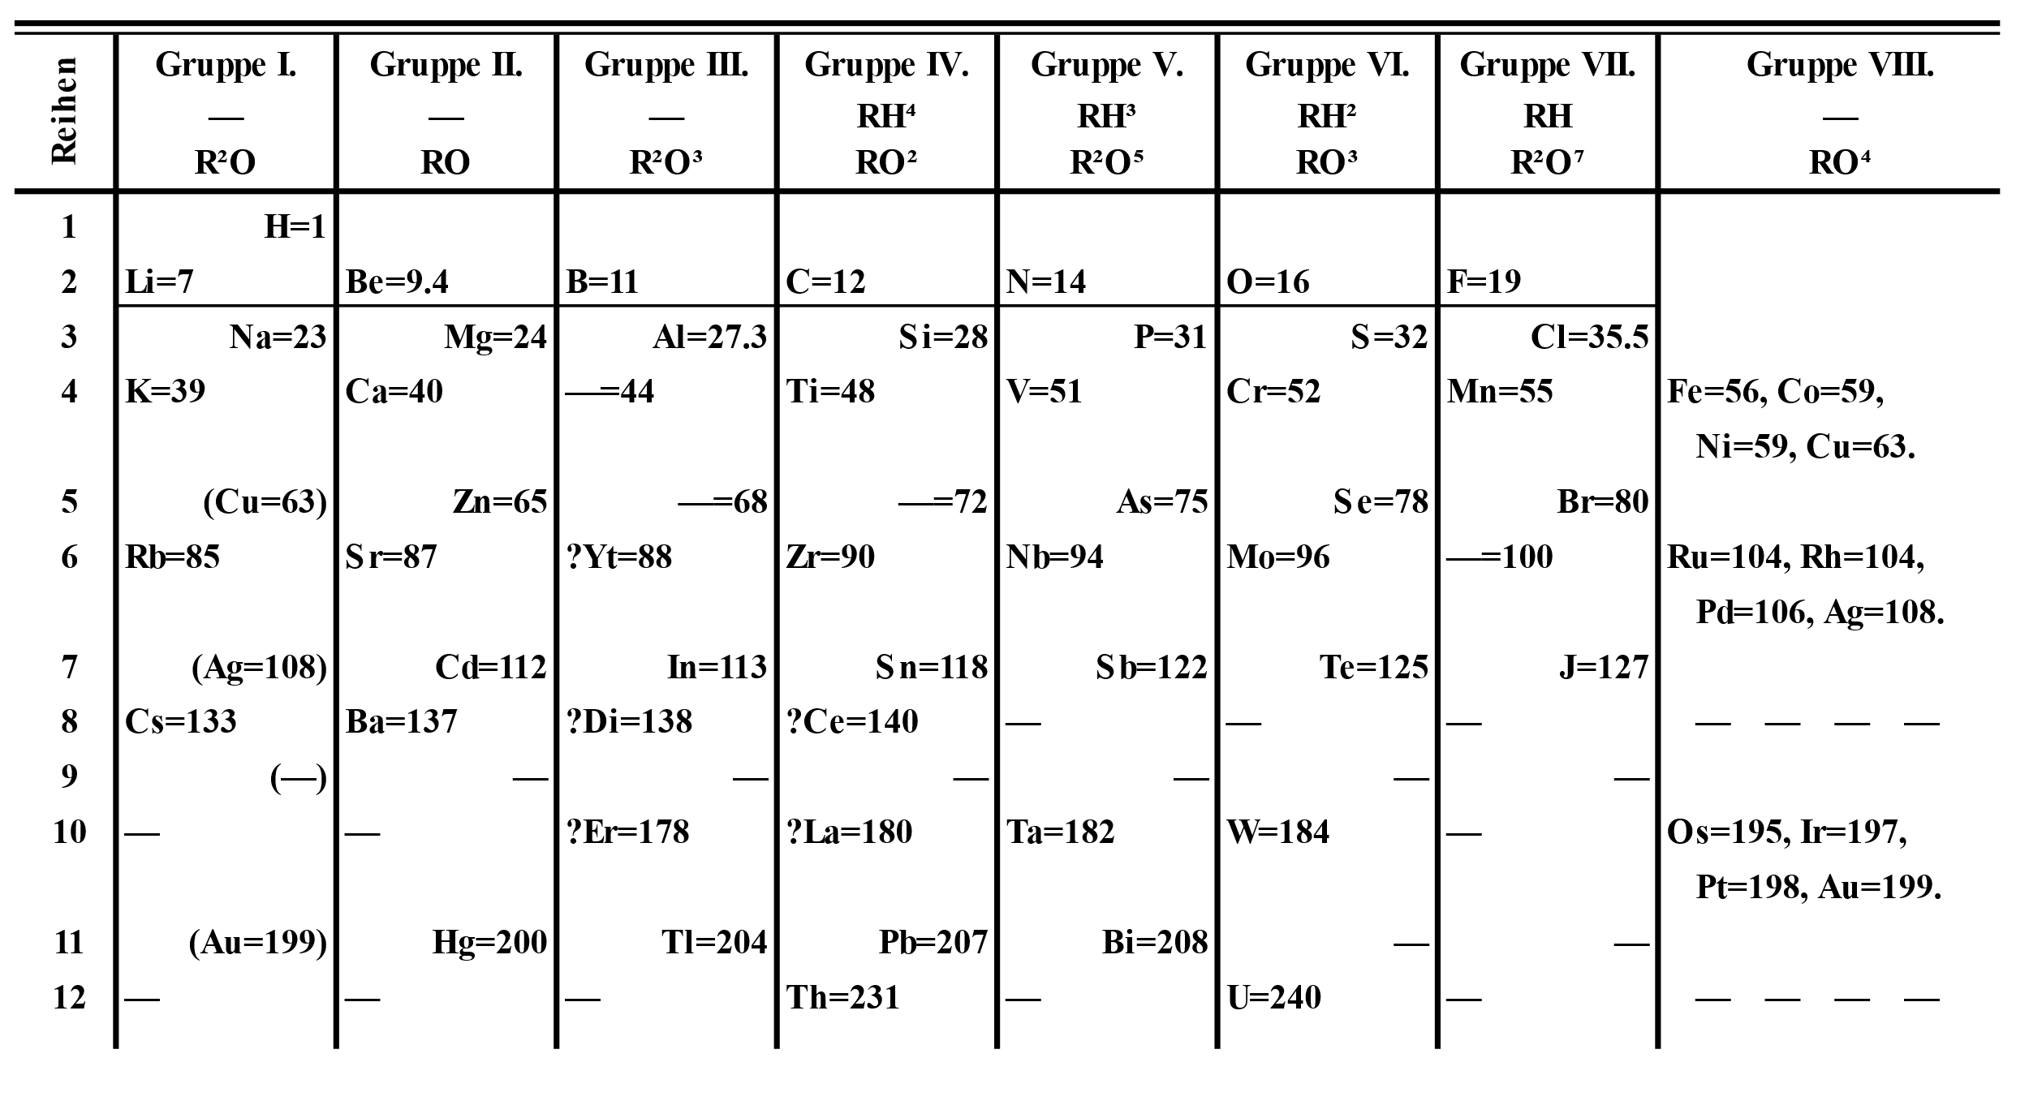
By NikNaks - Own work, Public Domain, https://commons.wikimedia.org/w/index.php?curid=39385462
Notes:
More for tables. Relationships. Compression. Inference. Dmitri Mendeleev.

Slide 5
Dynamic arrays

Slide 6
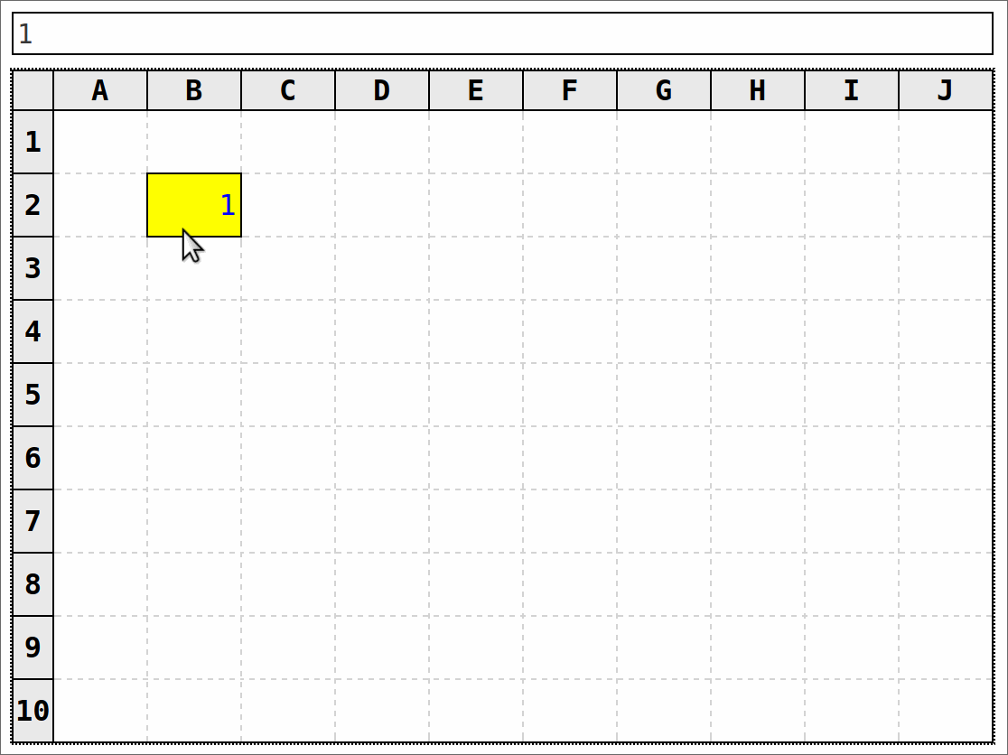
Notes:
Simple example of using Shakti as a formula language. Notice formatting is CSS-driven – Mesh passes information about the structure of your code to the client so that (eg) hardcodes and softcodes can be formatted differently. Crucially, display has no impact on the calculations. When you put a list in (say) D2, that reference applies to the whole list, not the first cell. This is not a problem for APL family languages like Shakti k! And in practice we rarely want to refer to individual elements of a list anyway. The advantage is that if the list expands into another cell, it doesn’t break the calculations (no collision of identities = no #SPILL! errors). Calculation is decoupled from the UI.
You can also give cells a name and it will be shown on the sheet. Write over the name and it will rewrite that reference automatically in places where it’s used.

Slide 7
Data structures

Slide 8
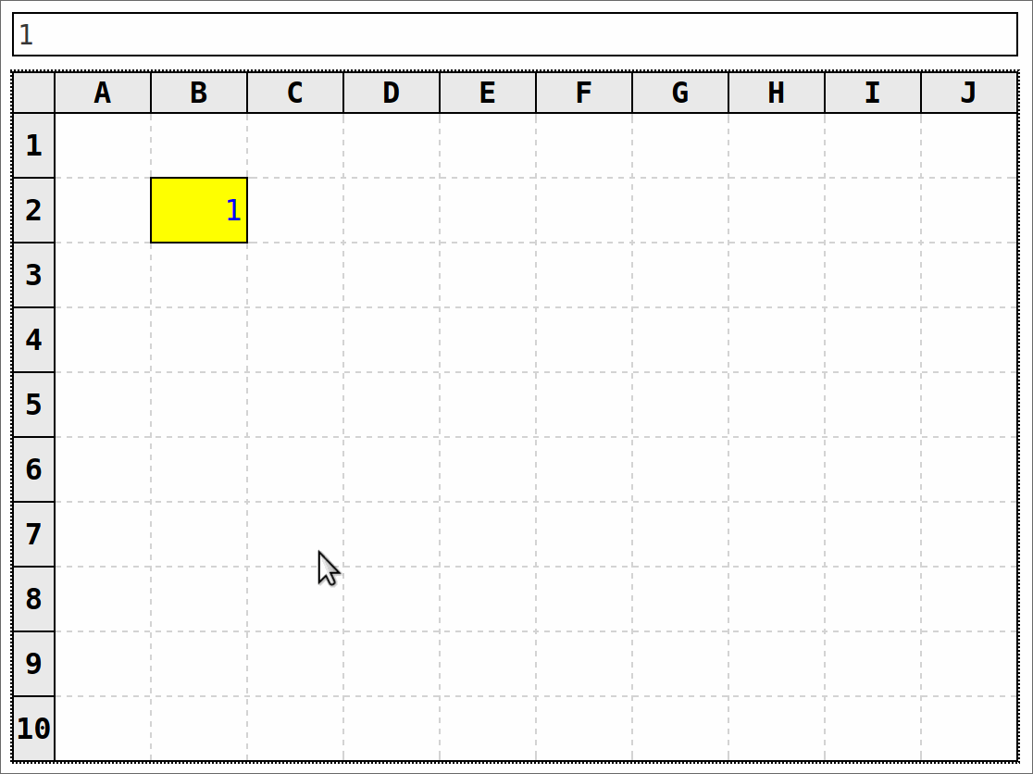
Notes:
You can also have list literals – and edit cells individually. You can also have dicts. And first-class functions…

Slide 9
Sheets as text

Slide 10
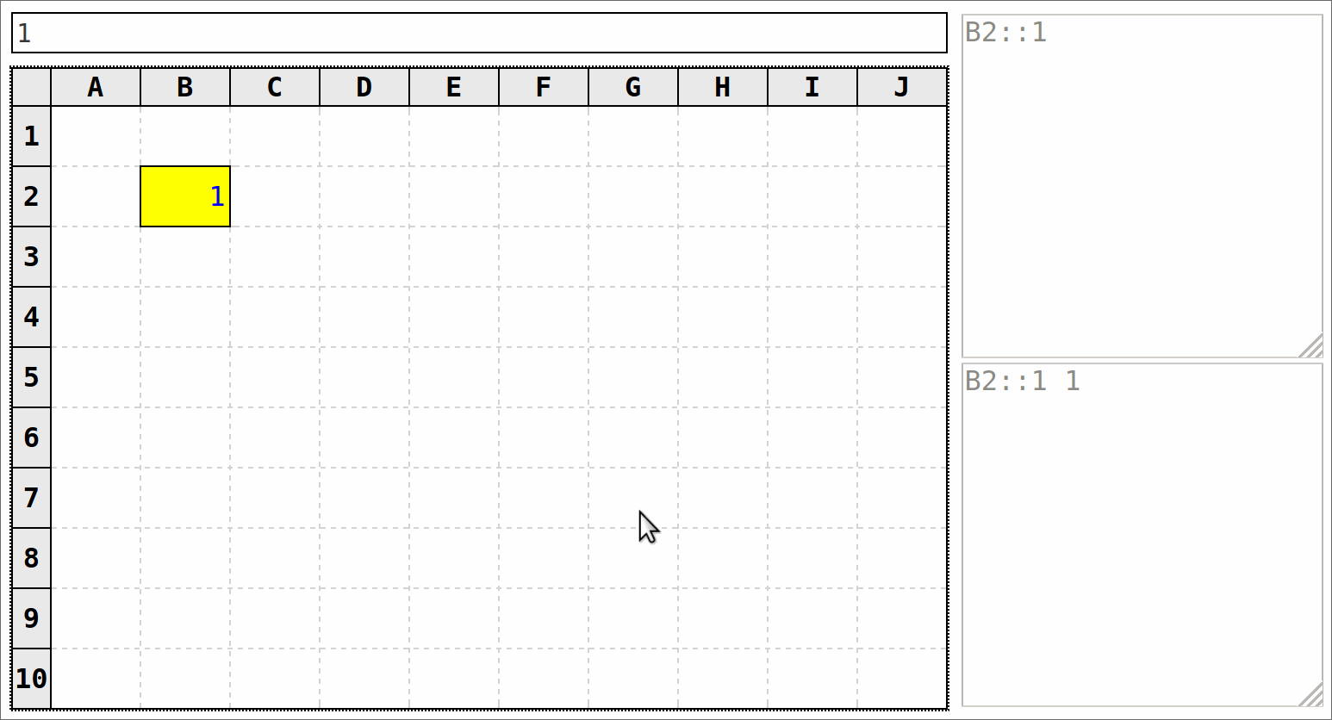
Notes:
Easy data entry. With no = at the start of the formular bar, Mesh will be ‘smart’ and turn your input into the literal you meant. In future updates we’ll also let you copy and paste data.
We’ll probably have separate files for sheet calcs and sheet display so that you know whether a change is purely cosmetic.
Important: sheets are *just text* - just Shakti programs. So you can diff them, easily use version control tools like Git, etc. You can also run the calculations without needing Mesh at all – it’s just Shakti code.

Slide 11
Example: loan schedule (JS prototype)

Slide 12
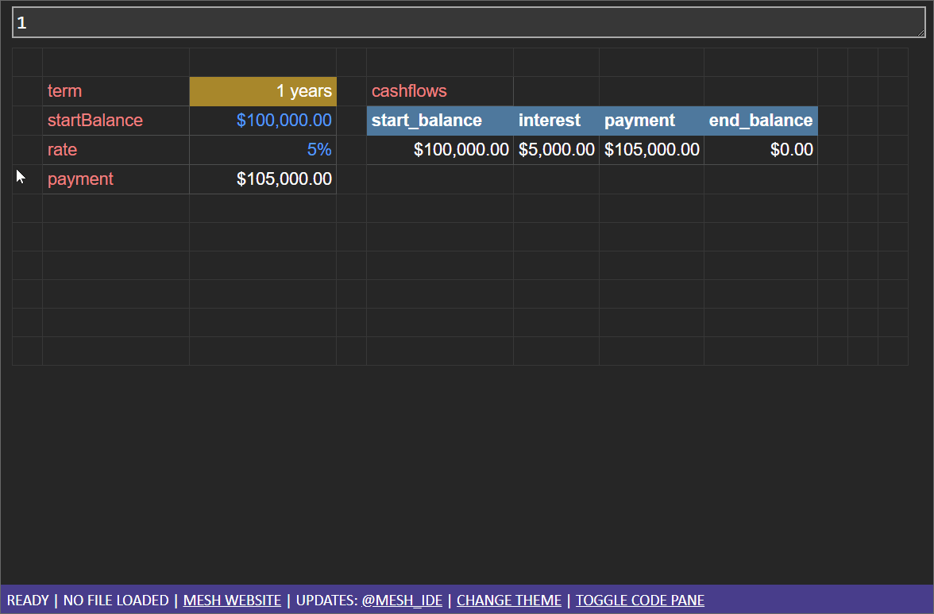
Notes:
Dynamic table resizing.
Notice the names (red text) – sometimes nicer to give more meaning than the cell’s location. Rename a cell by typing over the red text – it will update all references to that cell automatically.
Also notice the display-code-driven formatting (‘years’, %, $).

Slide 13
Streaming

Slide 14
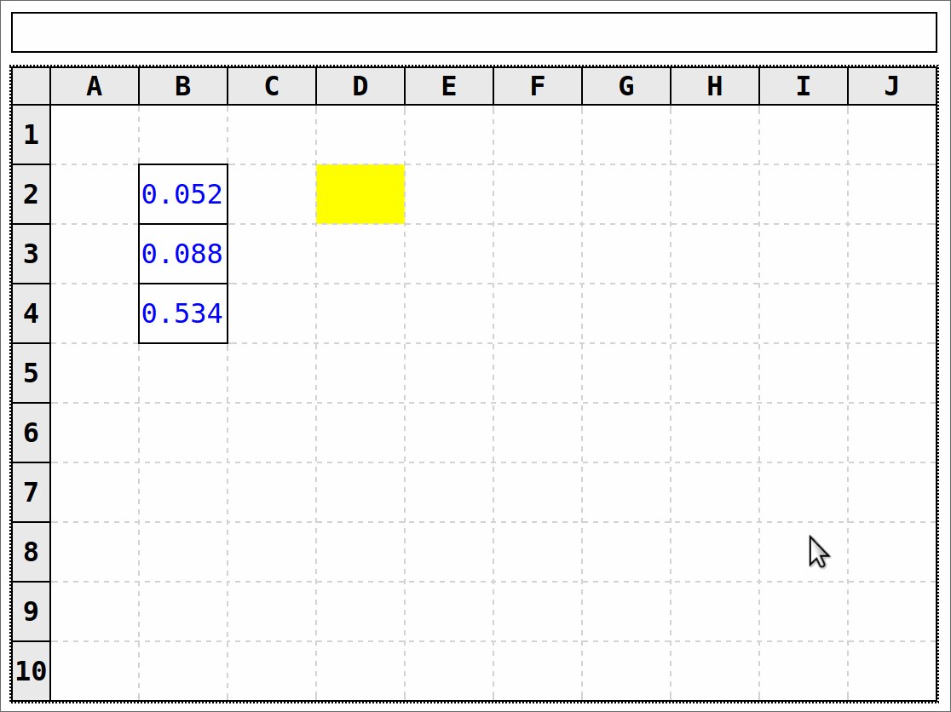
Notes:
Streaming data example. With views this will be a smart recalc – only what’s necessary.
Expose your sheet as a stateful or stateless API. Send data in, get results out.
Maybe you could view a running process and see what it’s doing, or send in some test data and see how it flows through the system.
You can imagine writing a web framework in something like this. Request comes in, response comes out, see all the processing in between (URL dispatch, templates, etc).
No heavy backend required – tiny Shakti runtime – so can start lots of instances of a sheet if you want, and setup/teardown very quickly.

Slide 15
Write real programs

Slide 16
Example: Mesh backend (JS prototype)
Notes:
Practicing what I preach.

Slide 17
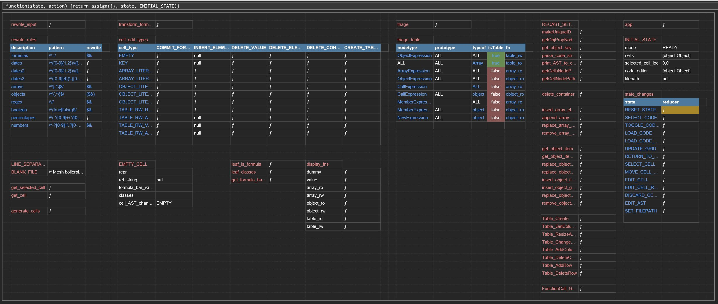
Notes:
(This is the JavaScript version – we should be able to do this in Shakti as well once dependencies arrive)
You can see some of the rich formatting that can automatically be applied – green/red for Booleans, tables, etc.
Lots of named cells – location-based referencing is great for quick work but it can be nicer to give it a name.
Perhaps this is a better way to see the high-level structure of a codebase than having to read/write docs or skim individual files?

Slide 18
Sign up to the mailing list!
mesh-spreadsheet.com
chrispsn@gmail.com

